Slide 1
IT 304 Computer Networks
Week 2-Lecture 1

Slide 2

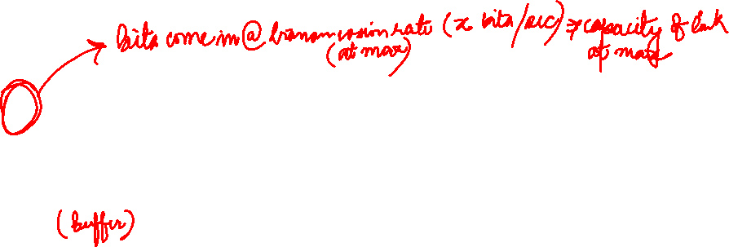
Packet Switching: queueing delay, loss
R = 100 Mb/s
C
A
D
R = 1.5 Mb/s
B
E
queue of packets
waiting for output link
queuing and loss:
if arrival rate (in bits) to link exceeds transmission rate of link for a period of time:
packets will queue, wait to be transmitted on link
packets can be dropped (lost) if memory (buffer) fills up

Slide 3
How do loss and delay occur?
packets queue in router buffers
packet arrival rate to link (temporarily) exceeds output link capacity
packets queue, wait for turn
packet being transmitted (delay)
A
B
packets queueing (delay)
free (available) buffers: arriving packets
dropped (loss) if no free buffers

Slide 4
Packet loss
queue (aka buffer) preceding link in buffer has finite capacity
packet arriving to full queue dropped (aka lost)
lost packet may be retransmitted by previous node, by source end system, or not at all
buffer
(waiting area)
A
packet being transmitted
B
packet arriving to
full buffer is lost
* Check out the Java applet for an interactive animation on queuing and loss

Slide 5
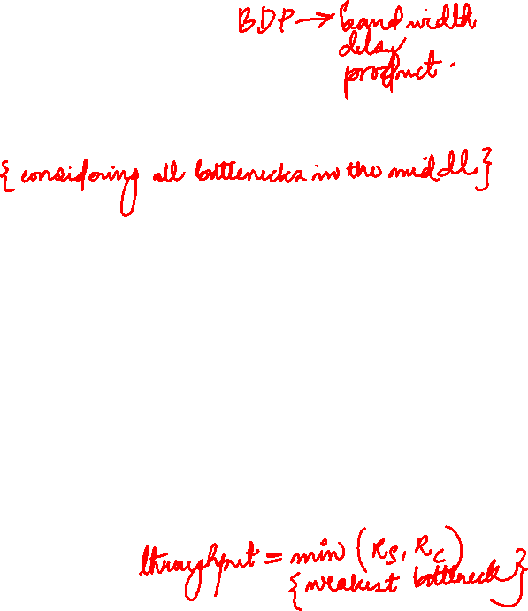
Throughput
throughput: rate (bits/time unit) at which bits transferred between sender/receiver
instantaneous: rate at given point in time
average: rate over longer period of time
server, with
file of F bits
to send to client
link capacity
R_{s} bits/sec
link capacity
R_{c} bits/sec
server sends bits
(fluid) into pipe
pipe that can carry
fluid at rate
R_{s} bits/sec)
pipe that can carry
fluid at rate
R_{c} bits/sec)

Slide 6
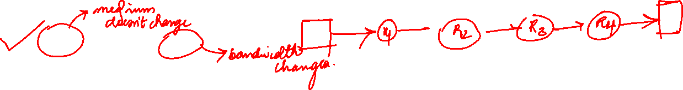
If four routers are separated by 10km, but with different capacity optical fibre cables, which delay component will be constant and which one will vary?
A. d_{prop} constant, d_{trans} varying
B. d_{prop} varying, d_{trans} varying
C. d_{prop} varying, d_{trans} constant
D. d_{prop} constant, d_{trans} constant

Slide 7
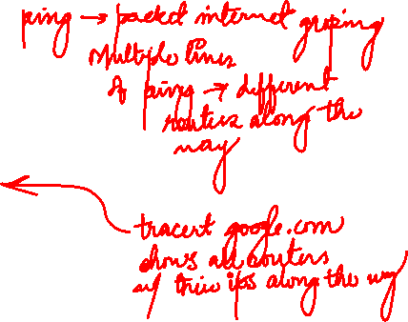
“Real” Internet delays and routes
what do “real” Internet delay & loss look like?
traceroute program: provides delay measurement from source to router along end-end Internet path towards destination. For all i:
sends three packets that will reach router i on path towards destination
router i will return packets to sender
sender times interval between transmission and reply.
3 probes
3 probes
3 probes

Slide 8
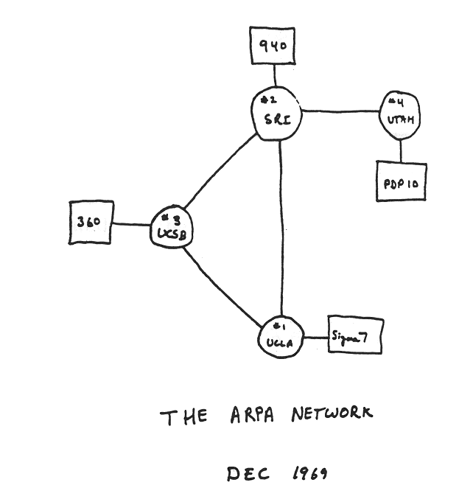
Internet history
1961-1972: Early packet-switching principles
1961: Kleinrock - queueing theory shows effectiveness of packet-switching
1964: Baran - packet-switching in military nets
1967: ARPAnet conceived by Advanced Research Projects Agency
1969: first ARPAnet node operational
1972:
ARPAnet public demo
NCP (Network Control Protocol) first host-host protocol
first e-mail program
ARPAnet has 15 nodes

Slide 9
First Packet switch
What was the first message sent across the network?

Slide 10
Internet history
1972-1980: Internetworking, new and proprietary networks
1970: ALOHAnet satellite network in Hawaii
1974: Cerf and Kahn - architecture for interconnecting networks
1976: Ethernet at Xerox PARC
late70’s: proprietary architectures: DECnet, SNA, XNA
1979: ARPAnet has 200 nodes
Cerf and Kahn’s internetworking principles:
minimalism, autonomy - no internal changes required to interconnect networks
best-effort service model
stateless routing
decentralized control
define today’s Internet architecture

Slide 11
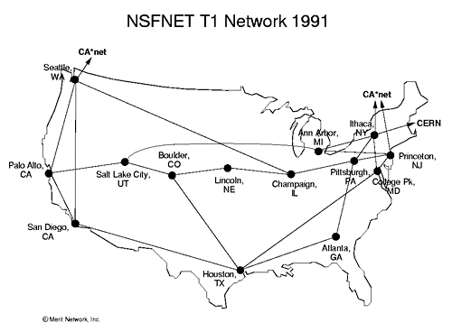
Internet history
1980-1990: new protocols, a proliferation of networks
1983: deployment of TCP/IP
1982: smtp e-mail protocol defined
1983: DNS defined for name-to-IP-address translation
1985: ftp protocol defined
1988: TCP congestion control
new national networks: CSnet, BITnet, NSFnet, Minitel
100,000 hosts connected to confederation of networks

Slide 12
Internet history
1990, 2000s: commercialization, the Web, new applications
early 1990s: ARPAnet decommissioned
1991: NSF lifts restrictions on commercial use of NSFnet (decommissioned, 1995)
early 1990s: Web
hypertext [Bush 1945, Nelson 1960’s]
HTML, HTTP: Berners-Lee
1994: Mosaic, later Netscape
late 1990s: commercialization of the Web
late 1990s – 2000s:
more killer apps: instant messaging, P2P file sharing
network security to forefront
est. 50 million host, 100 million+ users
backbone links running at Gbps

Slide 13
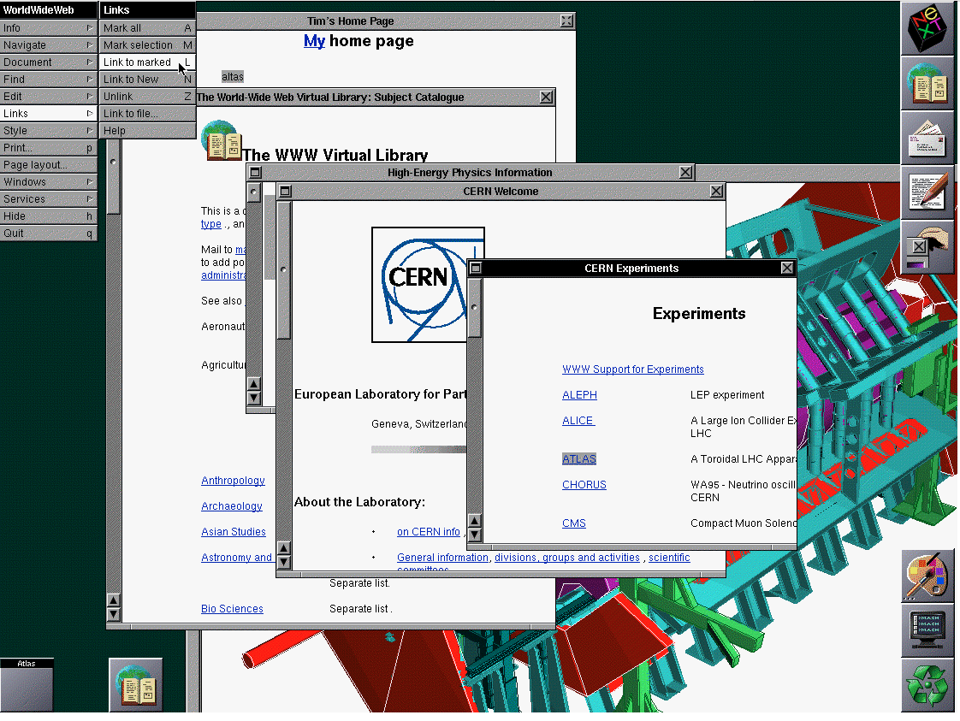
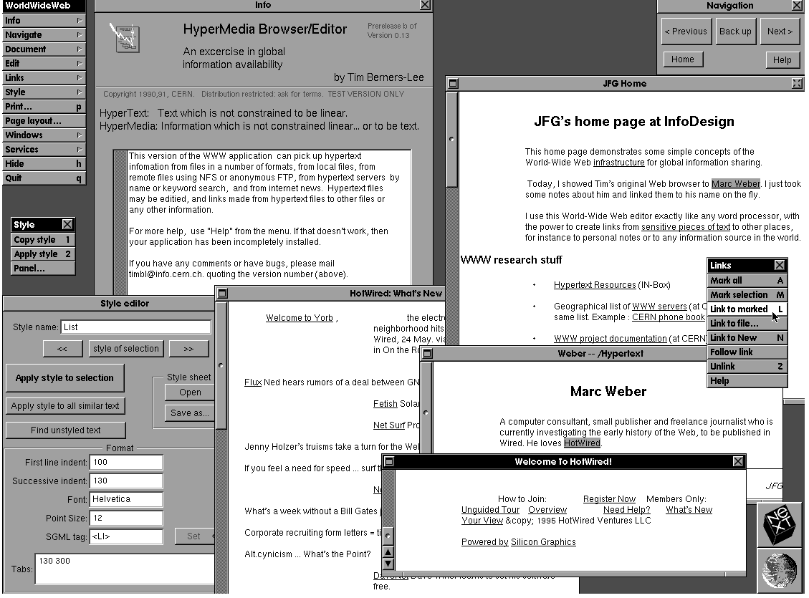
Tim Berners-Lee
HTML, HTTP, Web server, Browser
https://www.w3.org/People/Berners-Lee/WorldWideWeb.html

Slide 14
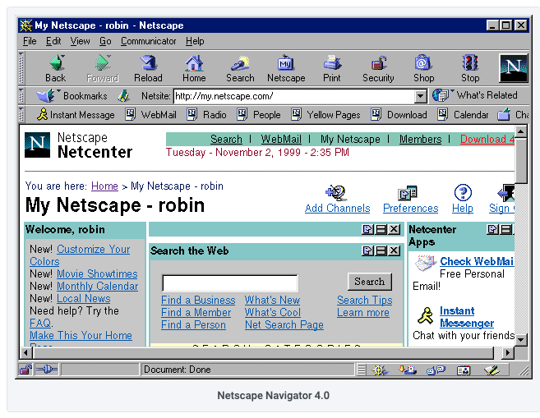
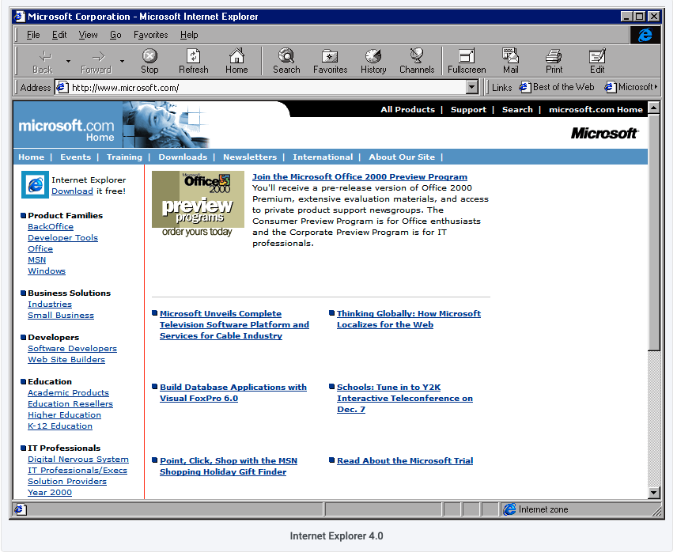
Browsers

Slide 15
Internet history
2005-present: scale, SDN, mobility, cloud
aggressive deployment of broadband home access (10-100’s Mbps)
2008: software-defined networking (SDN)
increasing ubiquity of high-speed wireless access: 4G/5G, WiFi
service providers (Google, FB, Microsoft) create their own networks
bypass commercial Internet to connect “close” to end user, providing “instantaneous” access to social media, search, video content, …
enterprises run their services in “cloud” (e.g., Amazon Web Services, Microsoft Azure)
rise of smartphones: more mobile than fixed devices on Internet (2017)
~15B devices attached to Internet (2023, statista.com)

